Slide 1
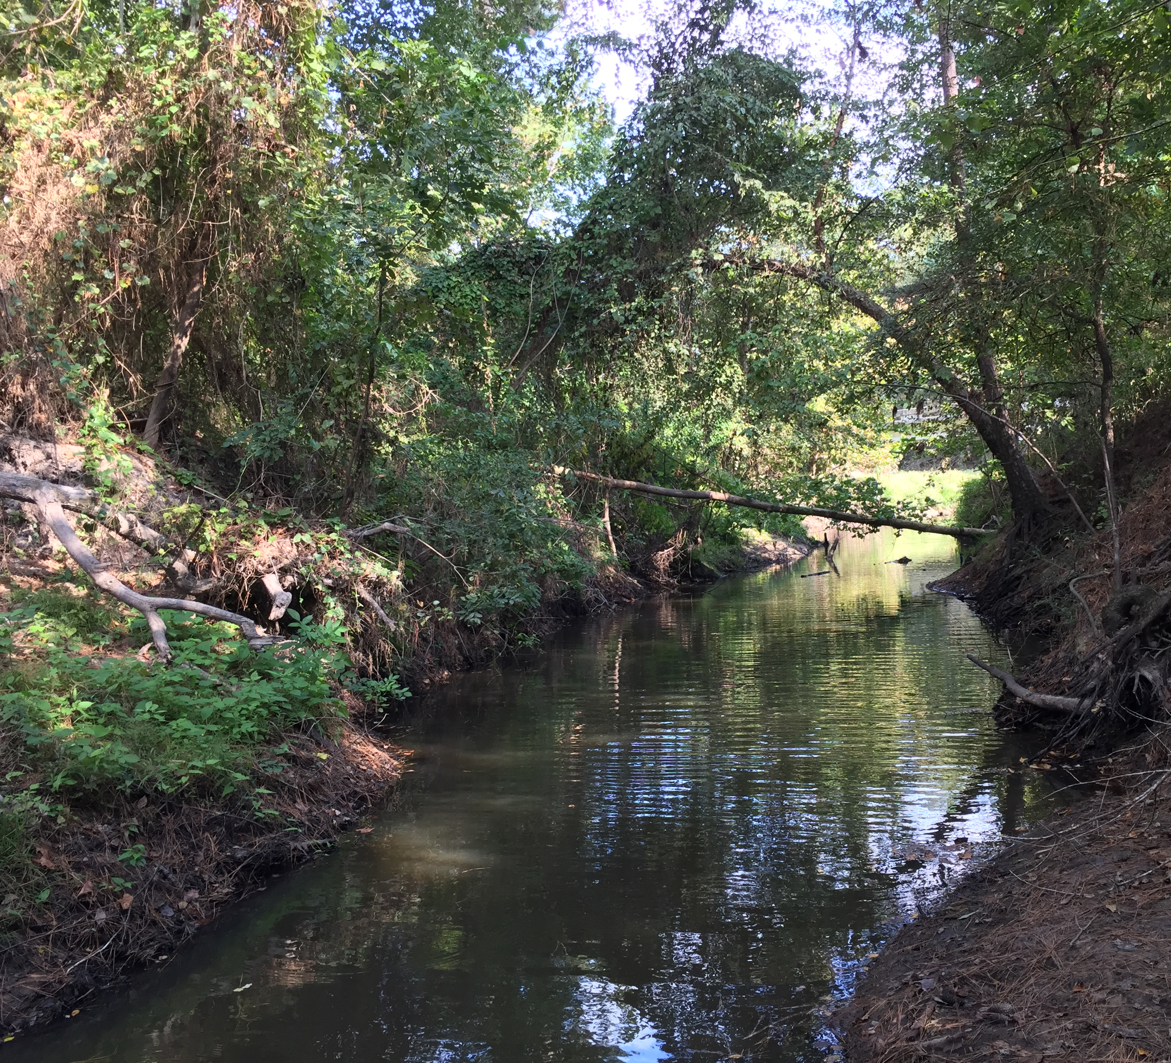
Site-Specific Criteria Changes
Elizabeth Malloy
Water Quality Standards
SiTe-Specific coordinator
Notes:
This presentation provides an overview of recommended site-specific criteria changes for our upcoming water quality standards revision. Site-specific standards are only applicable to a specific area, waterbody, or part of a waterbody.
There is a handout that outlines the Site-specific changes associated with this presentation.

Slide 2
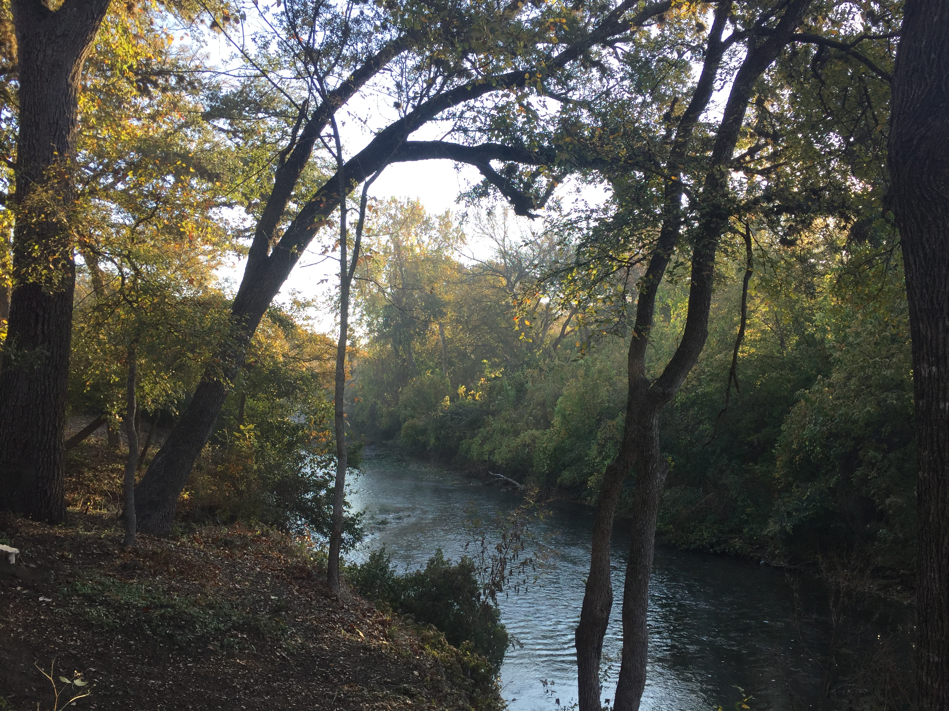
Recommended Site-Specific Changes
One change in Appendix A
One change in Appendix D
      Based on UAA analyses
Notes:
This presentation will cover one recommended change for Appendix A and one recommended change for Appendix D in the water quality standards.
Appendix A contains designated uses and supporting numerical criteria for the state’s classified segments. Appendix D contains site-specific aquatic life uses and associated dissolved oxygen criteria for unclassified streams.
We will recommend additional Appendix D changes that are not discussed in this presentation. They will be covered in the next work group meeting in May.

Slide 3
Appendix A Recommended PWS Use Change
Segment | Waterbody | Designated use altered | Recommended changes
1244 | Brushy Creek | Public Water Supply (PWS) | Removal of PWS designated use from the confluence with the San Gabriel river upstream to the most downstream edge of the Edwards Aquifer transition zone
Notes:
Appendix A lists site-specific uses and criteria for classified segments.
Brushy Creek currently has a designated use for public water supply (PWS) throughout the segment. We recommend removing this use downstream of the Edwards Aquifer zones. This is not an existing use downstream of the aquifer regions. We additionally consulted the Water Supply Division to ensure that that this recommended change would not negatively impact public drinking water supplies.
We are not recommending any use changes within the Edwards Aquifer zones. We will still retain the PWS use on Brushy Creek within all portions of the Edwards Aquifer. This also does not affect the aquifer protection use designation on Brushy Creek.

Slide 4
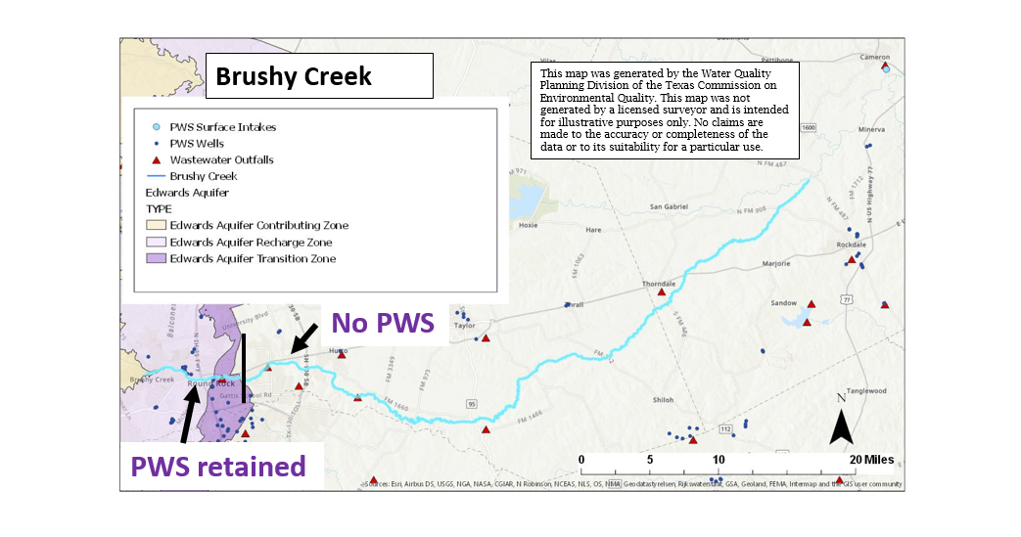
Appendix A Changes
Notes:
This is a map of the entire segment of Brushy Creek. The shaded yellow and purple regions to the left show the Edwards Aquifer zones. Any part of Brushy Creek that is within those zones will retain the PWS designated uses. The Edwards Aquifer is a sensitive area, and there are nearby public water supply wells (blue circles).
We are recommending removal of the PWS use downstream (to the right) of the most downstream edge of the aquifer recharge zone (shown in purple). There are no public water supply surface intakes or PWS groundwater wells nearby the stream in this section.

Slide 5
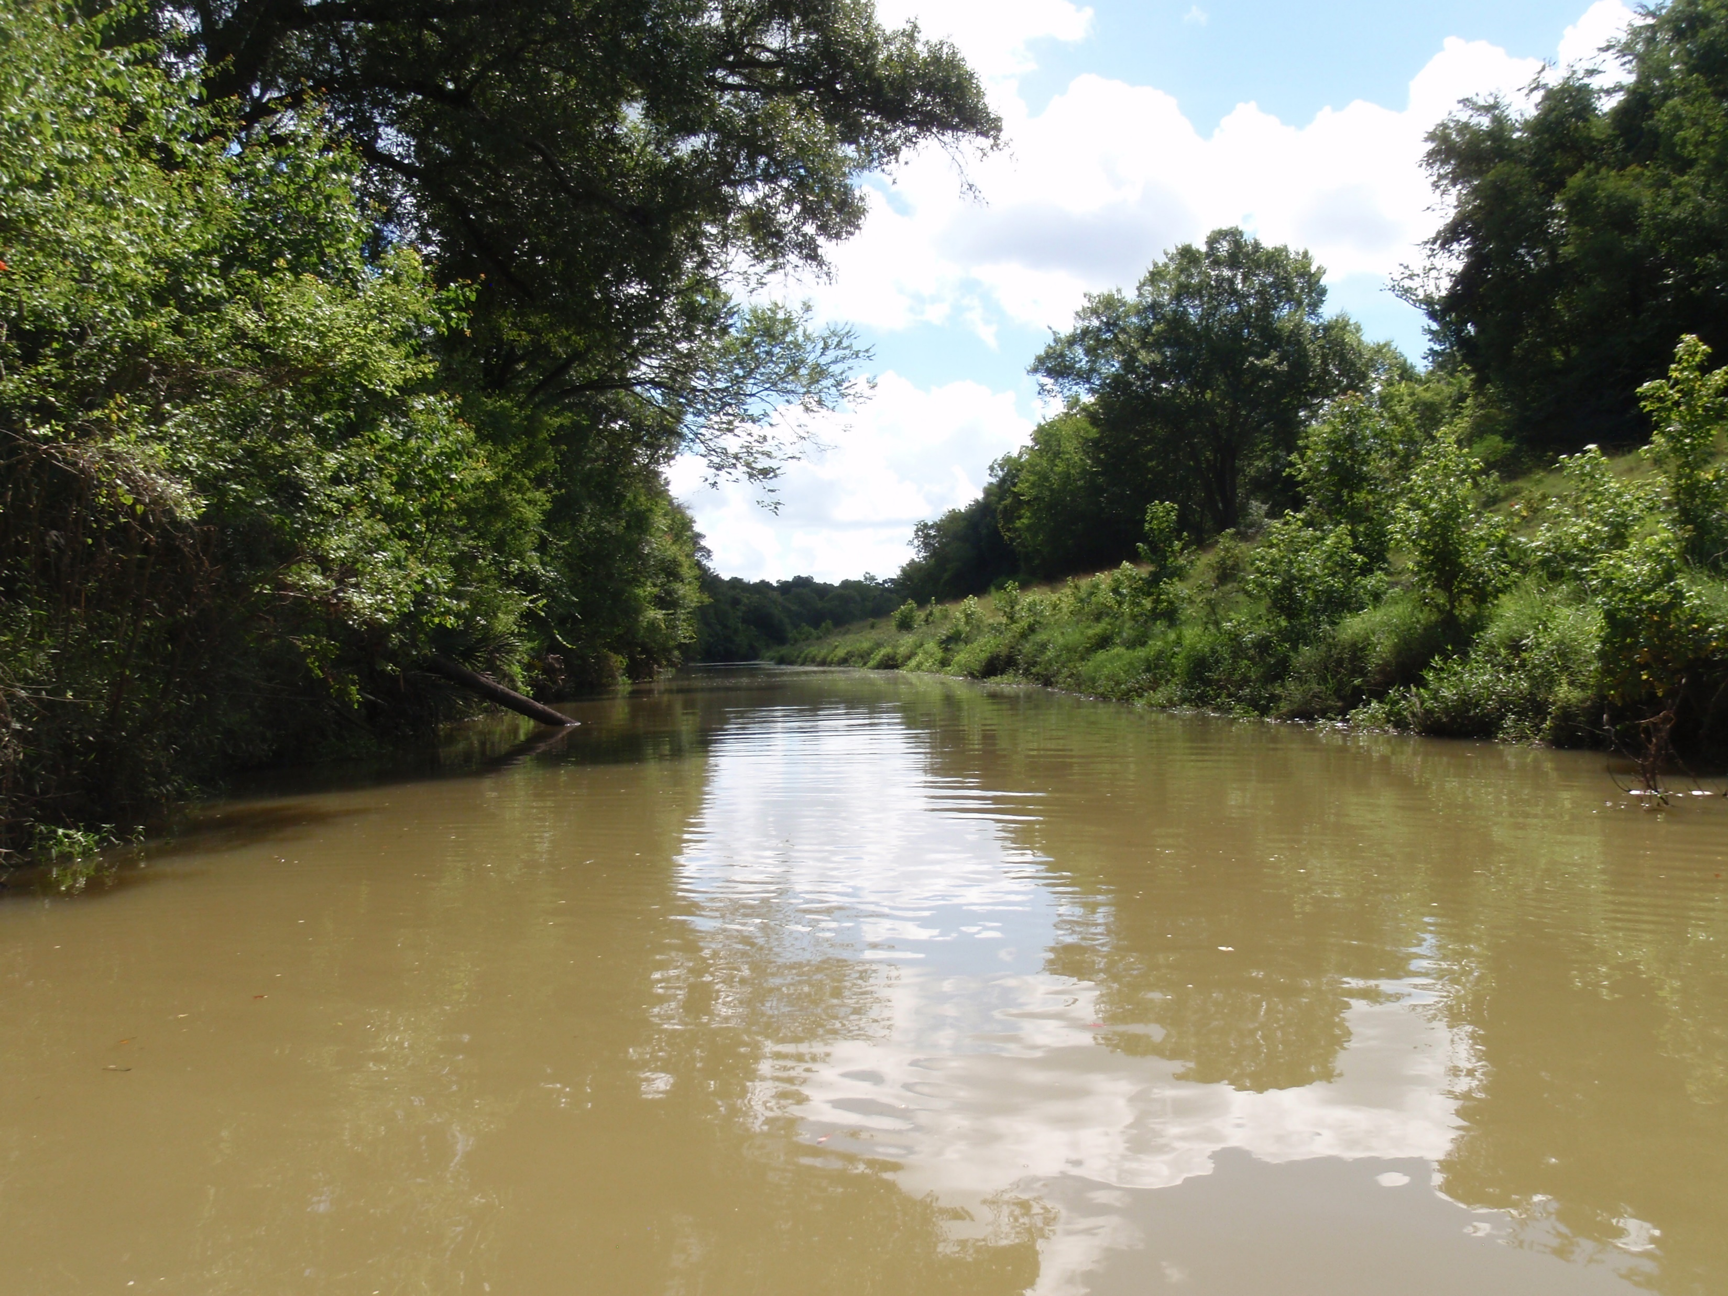
Appendix D Recommended Change
1402C Buckners Creek
Stream split into three sections with site-specific DO criteria based on flow regime
Notes:
We are covering one recommended change in Appendix D in this workgroup meeting. Appendix D of the water quality standards contains site-specific uses and criteria for unclassified waterbodies. Recommended changes are based on data from a use-attainability analysis (UAA).

Slide 6
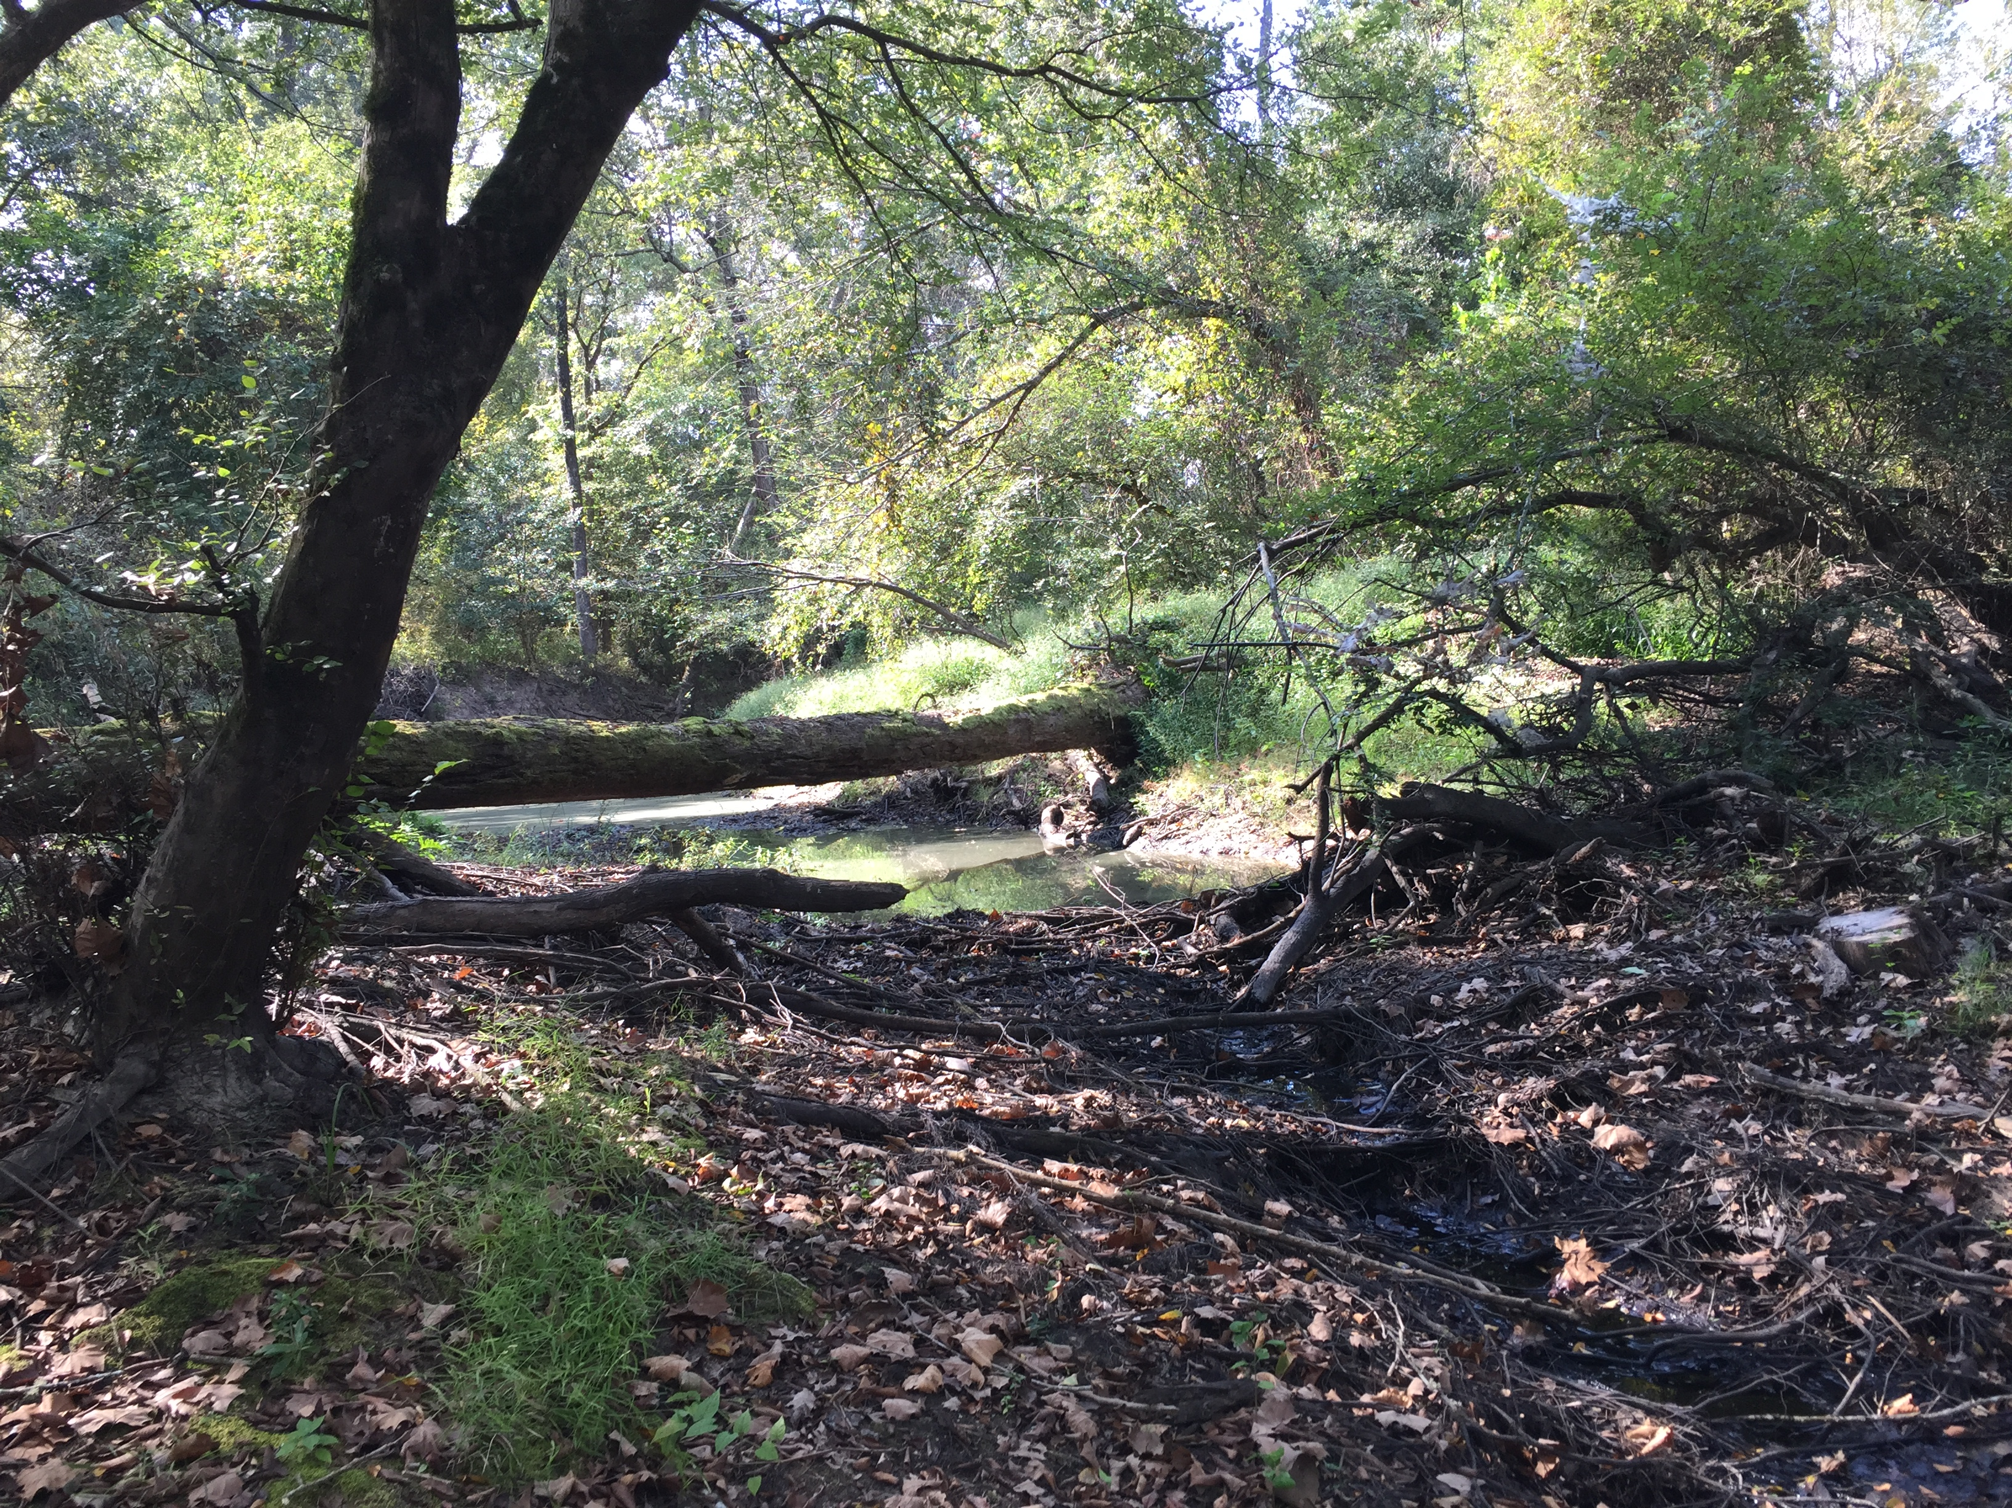
Use-Attainability Analyses (UAA)
Assessment of the physical, chemical, biological, and economic factors affecting attainment of a water body use
Evaluate and determine the attainable use of a water body
Used to support confirming, adding, or removing a use
Notes:
A use-attainability analysis (usually called a UAA), is an assessment of the physical, chemical, biological, and economic factors affecting the attainment of a water body. A UAA answers questions about which designated uses and what level of designated uses are attainable. These analyses provide the data necessary to either support a use change or confirm that current designated uses for a waterbody are appropriate.

Slide 7
When is a UAA appropriate?
Preliminary assessment of data indicates that the attainable use for a water body might be lower than the presumed or designated use
To support the change of a use to a water body
To address a 303(d) listing for a category 5b water body
    Category 5b: A review of the water quality standards for a water body will be conducted
Notes:
A UAA is typically used when initial data indicates that a water body’s current designated or presumed use may not be attainable. For example, a UAA may be a good choice for a stream listed as impaired under the 303(d) list in the Integrated Report if existing information suggest that standards do not match attainable conditions.

Slide 8
Buckners Creek (1402C)
UAA conducted by Lower Colorado River Authority (LCRA) in 2018-2019
Downstream Assessment Unit (AU) first listed in 2010 Texas 303(d) List for depressed dissolved oxygen
Notes:
Waterbodies are broken down into Assessment Units (or AUs) for monitoring and assessment purposes.
AU_01 (downstream section) is listed on the 303(d) list of the Integrated Report as impaired for low DO.
A UAA was conducted between 2018 and 2019 by LCRA at sites in both AUs to assess the suitability of current standards.

Slide 9
Buckners Creek (1402C)
Current Site Description
AU | AU Description | ALU | ALU Designation Source | 24-hour DO criteria (mg/L)
AU_02 | Perennial stream from the confluence with Chandler Branch near FM 154 in Fayette County upstream to the headwaters at Patterson Road southeast of the City of Rosanky in Bastrop County | High | Presumption from flow type | 5.0 average/ 3.0 minimum
AU_01 | Perennial stream from the confluence with the Colorado River upstream to the confluence with Chandler Branch 1.6 km upstream of FM 154 in Fayette County | High | Appendix D | 5.0 average/ 3.0 minimum
* ALU= Aquatic Life Use
Notes:
This chart shows how this waterbody is currently assessed.
AU_01 (downstream section of this stream) is currently included in Appendix D. The original Appendix D listing was based on an aquatic resource characterization performed by LCRA on one site in AU_01 during mid to late 1990’s. This is also the section listed on the 303(d) list of the Integrated Report as impaired for low DO.
Both sections currently have a designated high Aquatic Life Use (or ALU).

Slide 10
Buckners Creek
Sites sampled 10 times for 24-hour DO. Three visits also included biological sampling.
No permitted dischargers
Land-use within watershed is largely rural with little development
This map was originally generated by the Lower Colorado River Authority and was included in the final report to the Texas Commission of Environmental Quality. This map was not generated by a licensed surveyor and is intended for illustrative purposes only. No claims are made to the accuracy or completeness of the data or to its suitability for a particular use.
Notes:
This is a map of land use within Buckners Creek watershed using the National Land Cover Database. It shows that land use is largely hay/pasture with some forested area and scrub/shrub. There is very little development in this watershed. Additionally, there are no permitted dischargers into waterbodies.
The most recent UAA sampled each site ten times over a period of two years. Biological sampling was additionally performed during three of these ten sample events. Biological sampling included habitat surveys as well as the collection of nekton and macroinvertebrate data.

Slide 11
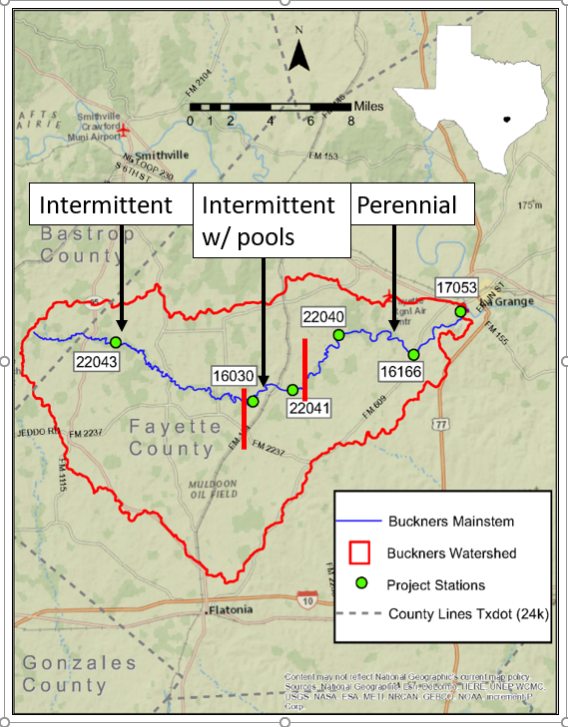
Buckners Creek
UAA results: Split into 3 sections based on flow regime
Section divisions based on UAA data
This map was generated by the Lower Colorado River Authority and the Texas Commission of Environmental Quality. This map was not generated by a licensed surveyor and is intended for illustrative purposes only. No claims are made to the accuracy or completeness of the data or to its suitability for a particular use.
Notes:
This map shows our recommendation to split the stream into three sections based on UAA data. Buckners Creek upstream of Live Oak Creek is intermittent. Between Pin Oak Creek and Live Oak Creek, the stream is intermittent with pools. The downstream section is perennial.

Slide 12
Buckners Creek
Upstream
Upstream site only had measurable flow on one out of ten visits
Dried completely on two visits
Minimal Aquatic Life Use (ALU)
Presumed DO criteria of 2.0 mg/L average and 1.5 mg/L minimum
Notes:
Upstream part of Buckners Creek had an intermittent flow regime and only had measurable flow on one of the ten visits. Intermittent streams have a minimal aquatic life use and a presumed DO criteria of 2.0 mg/L average and 1.5 mg/L minimum.

Slide 13
Buckners Creek
Middle
Intermediate Aquatic Life Use (ALU)
Station | Nekton Category | Habitat Category | Benthics Category
16030 | Intermediate | Intermediate | Intermediate
22041 | Intermediate | Intermediate | Intermediate
Notes:
This table shows average results for UAA biological sampling by station. UAA data indicate that this section of the stream can support an intermediate ALU.
We also recommend a dissolved oxygen criteria of 3.0 mg/L average and 2.0 mg/L minimum based off of UAA data. This is also the DO criteria typically presumed for streams with an intermittent with pools flow regime.

Slide 14
Buckners Creek
Downstream
High Aquatic Life Use
Station | Nekton Category | Habitat Category | Benthics Category
22040 | High | Intermediate | Intermediate
16166 | High | High | High
17053 | High | Intermediate | High
Notes:
This table shows average results for the UAA biological sampling by station. Although results varied slightly for habitat and benthics, sampling results generally show that this waterbody can support a high ALU. These results support the current high ALU already listed in Appendix D for this part of the stream.
We recommend that the current DO criteria of 5.0 mg/L average and 3.0 mg/L minimum should also be retained based on UAA data.

Slide 15
Buckners Creek:
Recommended Uses and Criteria
Section | Description | Flow Regime | Aquatic Life Criteria | DO Criteria (mg/L)
Upstream | From confluence with Live Oak Creek upstream to headwaters | Intermittent | Minimal | 2.0 average/ 1.5 minimum
Middle | From confluence with Pin Oak Creek upstream to Live Oak Creek | Intermittent with Pools | Intermediate | 3.0 average/ 2.0 minimum
Downstream | From confluence with Colorado River upstream to Pin Oak Creek | Perennial | High | 5.0 average/ 3.0 minimum
Update in Appendix D
Notes:
This table shows a summary of our recommendations for Buckners Creek. The upstream section will not be added to Appendix D of the water quality standards since it is an intermittent stream. We would add the middle section into Appendix D. The downstream section is already listed in Appendix D with the recommended ALU and DO criteria, but we would reduce the section boundary slightly to Buckner Creek’s confluence with Pin Oak Creek.

Slide 16
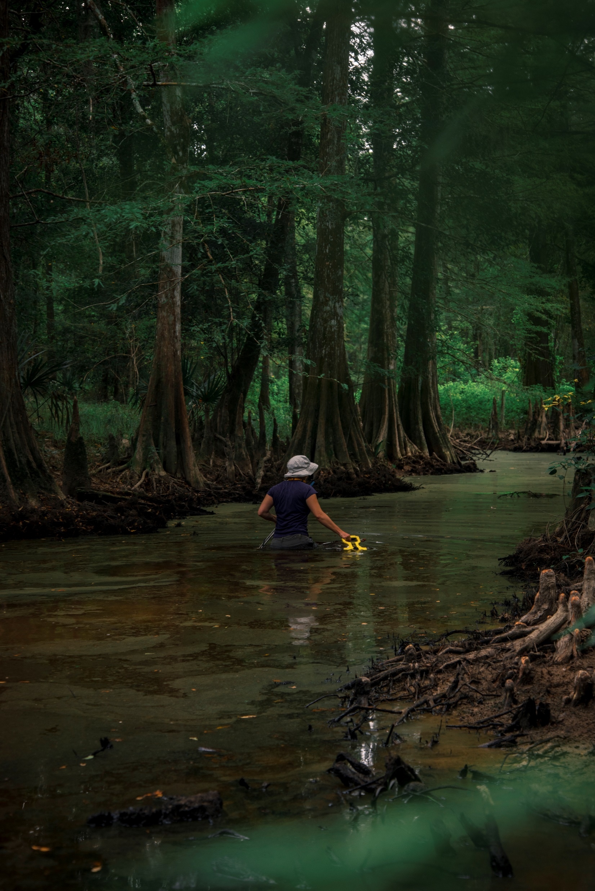
Contact Information
Elizabeth Malloy
Water Quality Standards Team
Site-specific Coordinator
Phone: 512-239-3166
Email: elizabeth.malloy@tceq.texas.gov
Notes:
This slide shows contact information for the site-specific coordinator.

Slide 17
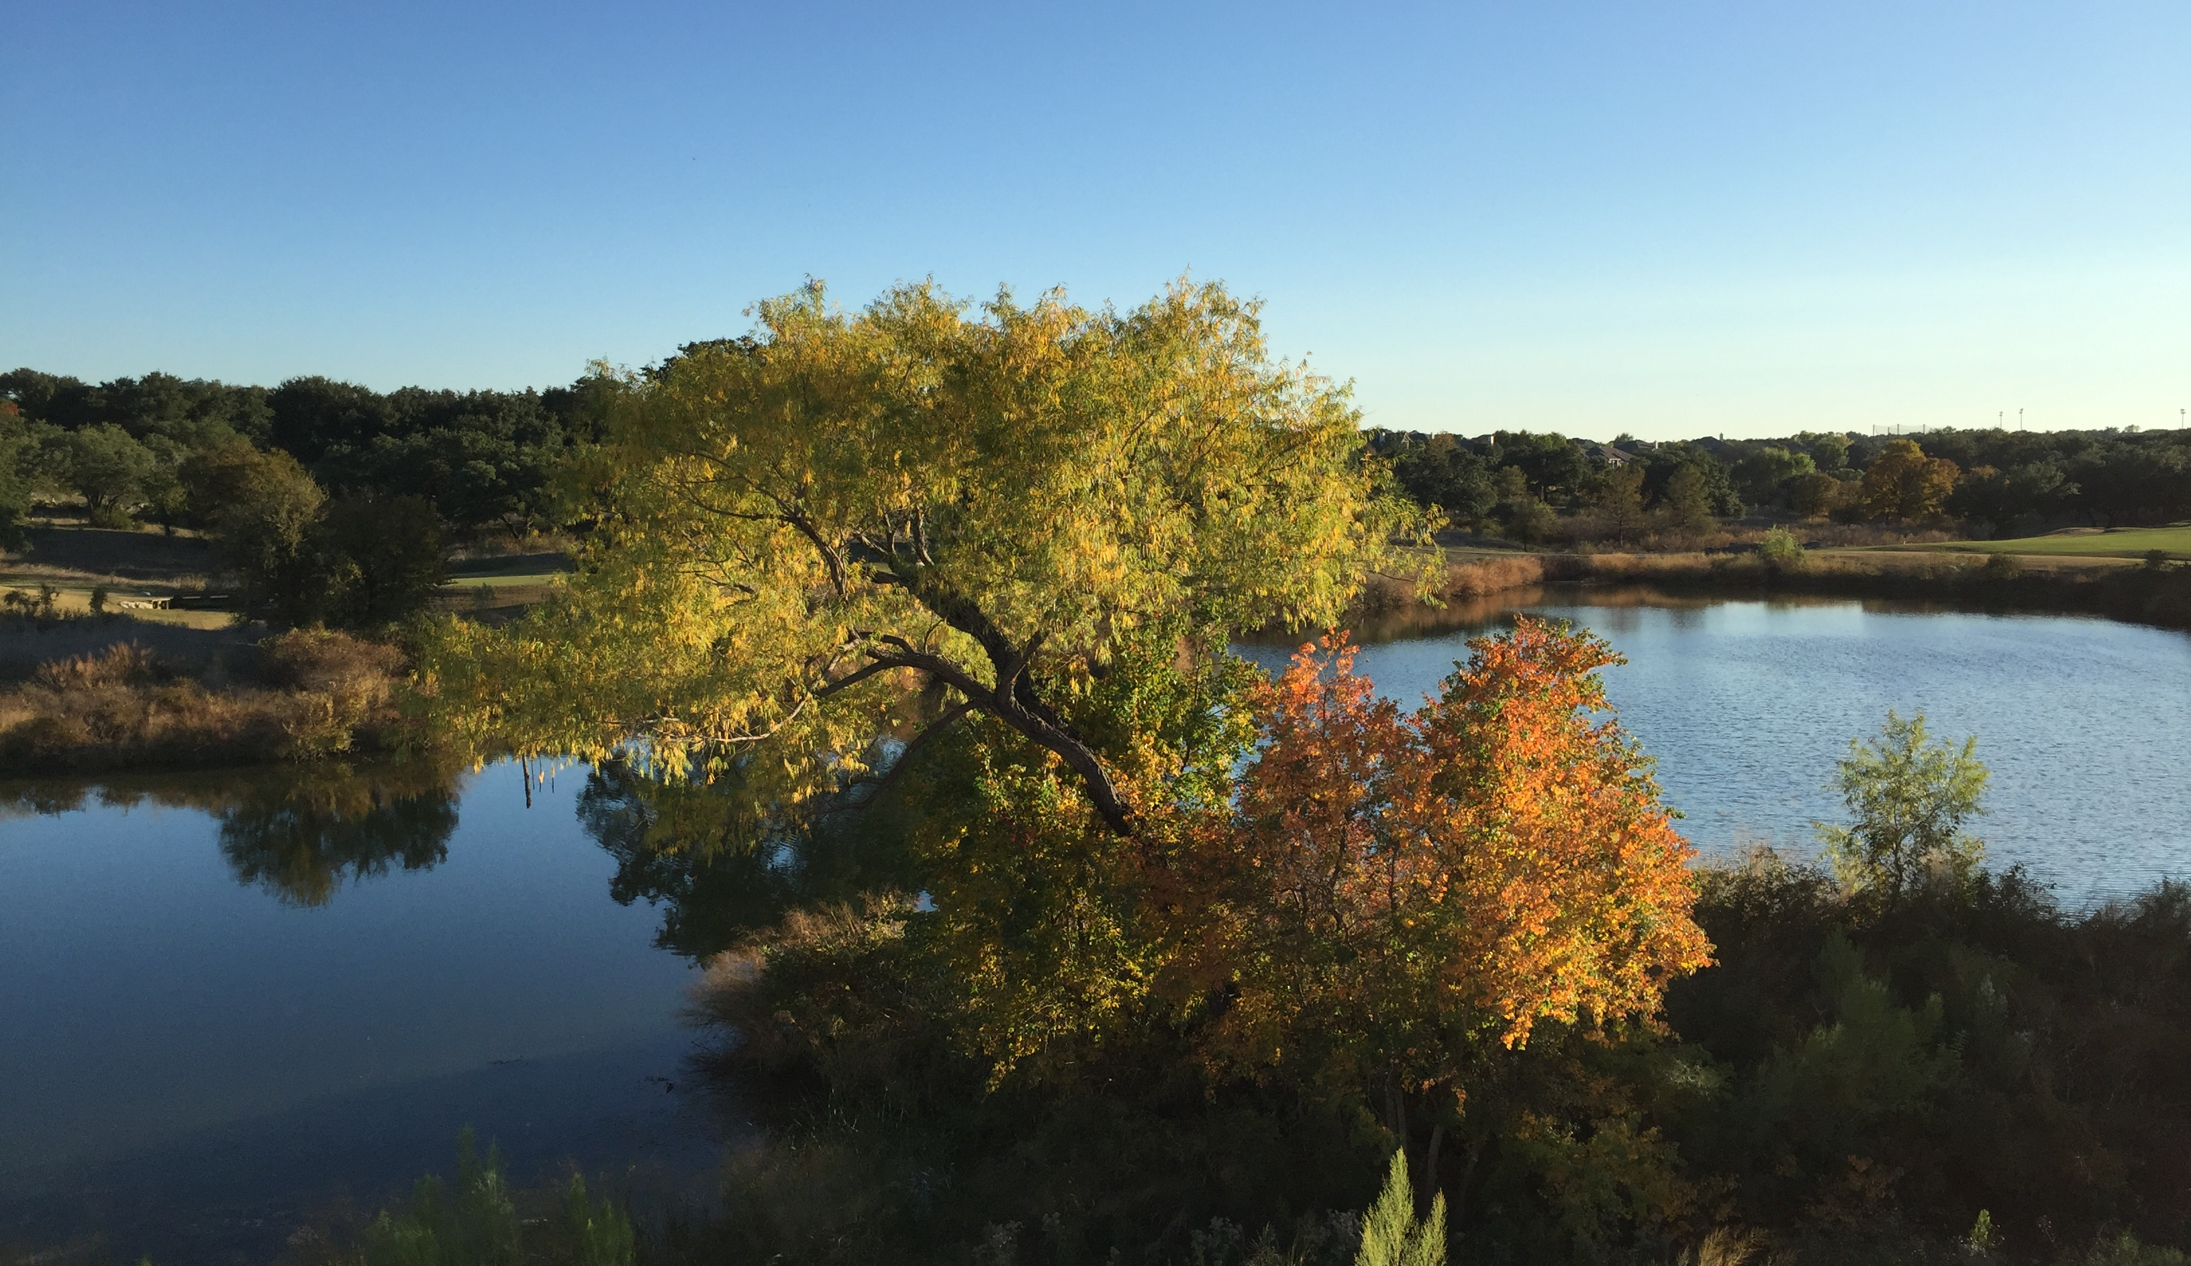
Questions?
Notes:
This slide is for display during questions

